Slide 1



Human Computer Interaction tool integrated within INTO-CPS
Alexandru Butean – Researcher at INCON Research Center
http://centers.ulbsibiu.ro/incon/
alexandru.butean@ulbsibiu.ro

Slide 2
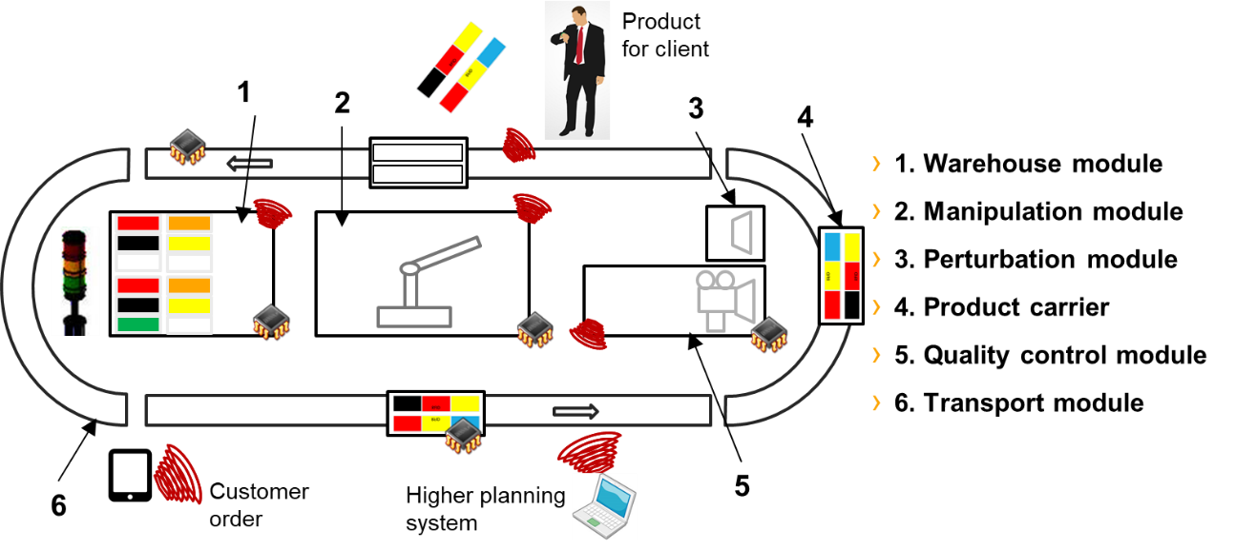
IPP4CPPS Concept
IPP4CPPS - Alexandru Butean - Integrated product-production co-simulation for cyber-physical production system

Slide 3
Objectives
design and build an integrated product-production co-simulation for CPS-based industrial control solution
deliver a proof-of-concept based on the combined forces of INTO-CPS, 20SIM and 4DIAC platforms
achieve a long-term multiplication effect with the implemented demo by attracting other companies to develop, use and adopt these technologies
IPP4CPPS - Alexandru Butean - Integrated product-production co-simulation for cyber-physical production system

Slide 4
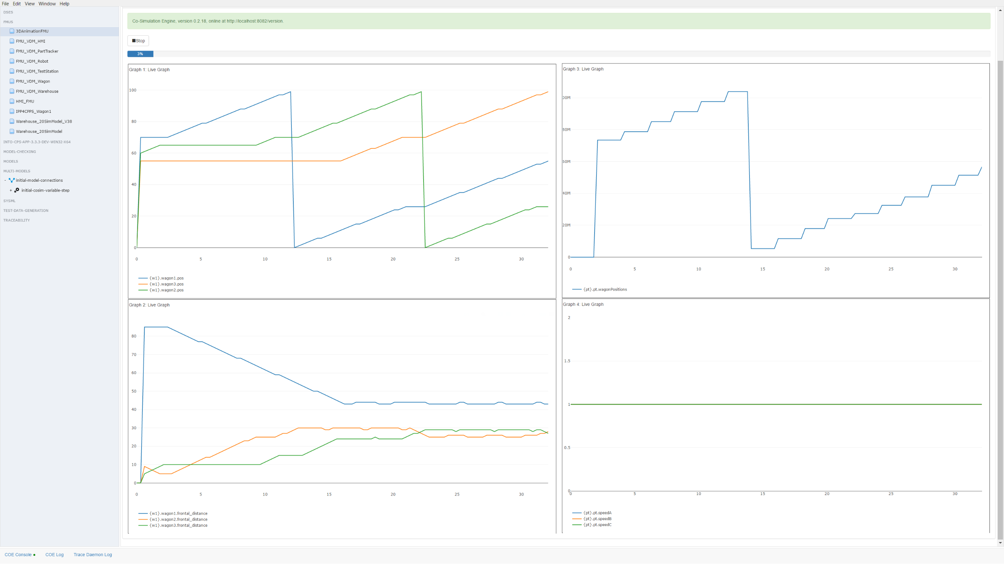

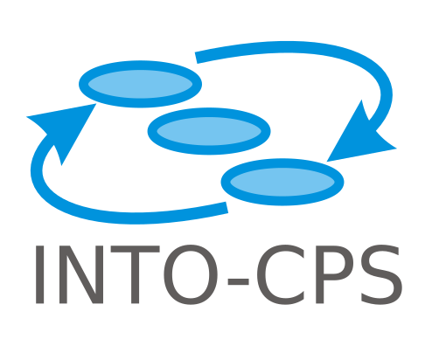

Co-simulation
IPP4CPPS - Alexandru Butean - Integrated product-production co-simulation for cyber-physical production system

Slide 5
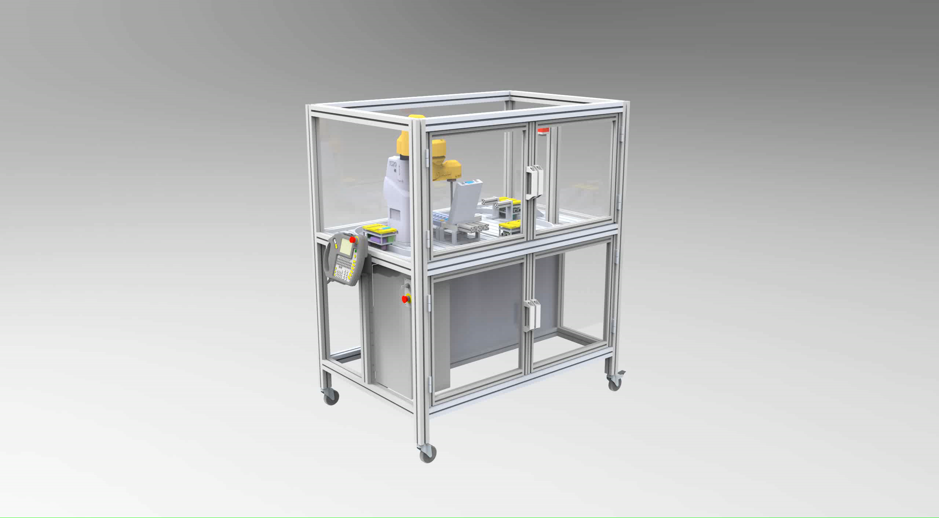
Modelling
IPP4CPPS - Alexandru Butean - Integrated product-production co-simulation for cyber-physical production system

Slide 6
Current status
80 % of the code was generated by the co-simulation and deployed on the physical modules
The integration between modules is ready.
Our CPS is alive autonomous and awaiting orders from the integrated HMI
All the modules are working according to specifications
IPP4CPPS - Alexandru Butean - Integrated product-production co-simulation for cyber-physical production system

Slide 7
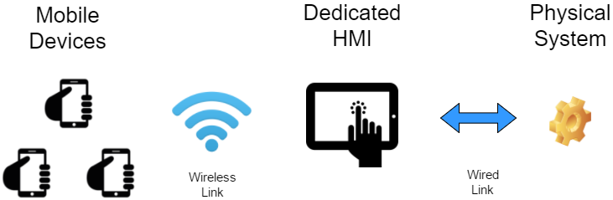
IPP4CPPS - HMI
HMI FMU – 4DIAC - INTO-CPS – SIMULATION (Custom)
HMI MQTT PROTOCOL – PHYSICAL (Custom)
IPP4CPPS - Alexandru Butean - Integrated product-production co-simulation for cyber-physical production system

Slide 8
INTO CPS EXTENSION – HMI Tool
Human centered - Simulation Tweaker Mixer – INTO CPS Based
Dynamic control of simulation – Mobile oriented
HMI Interface / Module – Dual mode – Simulation – Integration
Code generation – Incremental Approach
IPP4CPPS - Alexandru Butean - Integrated product-production co-simulation for cyber-physical production system

Slide 9
INTO CPS EXTENSION – Estimations and Prerequisite
8-12 months effort – Architecture, Development, Testing, Integration
Micro-financing (National, European)
Access to similar experiments, testbeds for relevancy
IPP4CPPS - Alexandru Butean - Integrated product-production co-simulation for cyber-physical production system

